Slide 1

Snorkeling through TAS/ADA in Galveston, and beyond…
SSD-Statewide Space Planning
presents

Slide 2
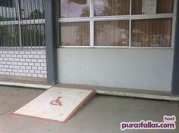
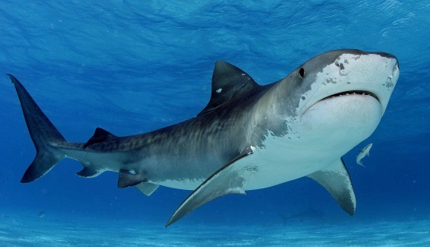
Question: Does my building or facility need to comply with TAS/ADA standards?

Slide 3

Question: Does my building or facility need to comply with TAS/ADA standards?
Answer:
All areas of newly designed and newly constructed buildings and facilities and altered portions of existing buildings and facilities shall comply with TAS/ADA requirements.
(a) A building or facility used by the public is subject to compliance with the Texas Accessibility Standards (hereinafter "TAS") if it is constructed, renovated, or modified, in whole or in part, on or after January 1, 1970, using funds from the state or a county, municipality, or other political subdivision of the state.
(b) A building or facility leased for use or occupied, in whole or in part, by the state under a lease or rental agreement entered into on or after January 1, 1972, is subject to the TAS except as modified under §68.101.

Slide 4
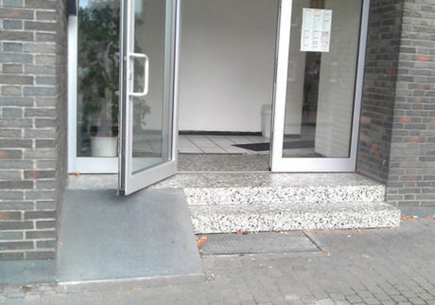

Question: Which of my projects do I need to register with TDLR?

Slide 5
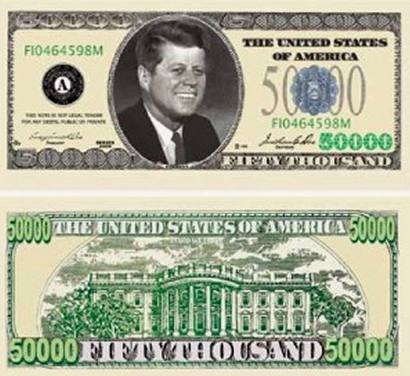

Question: Which of my projects do I need to register with TDLR?
Answer:
If a project’s construction costs are less than $50,000, you do not need to register it.

Slide 6


Question: Are all project costs included in that $50,000 construction cost?

Slide 7

Question: Are all project costs included in that $50,000 construction cost?
Answer:
No. Here are some items excluded from the construction cost:
-Site acquisition
-Consultant fees, architect fees
-Furnishings
-Equipment not part of the building mechanical equipment
-Asbestos abatement

Slide 8


Question: : If my project costs less than $50,000, does it need to comply with TAS/ADA standards?

Slide 9

Question: If my project costs less than $50,000, does it need to comply with TAS/ADA standards?
Answer:
Yes!

Slide 10

Question: Shouldn’t my existing facility be “grandfathered”?

Slide 11


Question: Shouldn’t my existing facility be “grandfathered”?
Answer:
No, “grandfathering” is not a term used in TAS/ADA.

Slide 12
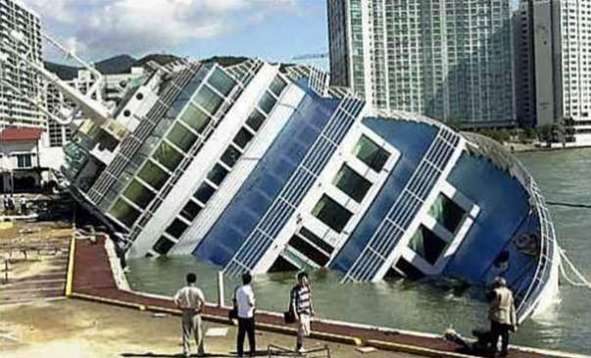
Question: Well, what about “Safe Harbor”? Does “Safe Harbor” apply?

Slide 13

Question: Well, what about “Safe Harbor”? Does “Safe Harbor” apply?
Answer: Sometimes. Safe harbor is defined in TAS 106.5.57. When the scope of work for a project involves alterations to an area of primary function and the path of travel elements (parking, accessible route, toilet rooms, drinking fountains and public telephones) that serve the altered area already comply with the 1994 TAS they are not required to reflect the requirements of the 2012 TAS, unless those elements of the path of travel are being altered.

Slide 14

Any questions?

